Slide 1
Course : Computational Biology
Effective Period : June 2022
Protein Synthesis Session 3

Slide 2
Objective and Outline
LO : Execute a planned simulation of Introduction to BioPython, DNA Sequence Analysis, and DNA Sequence Alignment
In this course we will be simulating basic Bioinformatics analysis using Biopython. Although the Python part is dominant, this course is still ideal for students only with a basic knowledge of biology. The course contains a basic introduction to the Jupyter Notebook and Colab Environment,
In this session, we will start exploring a simulation concept using Open-Source Biopython
Official Website : https://biopython.org/
Outline
Protein Synthesis
Amino Acid Codon Table
3D Structure of Protein

Slide 3
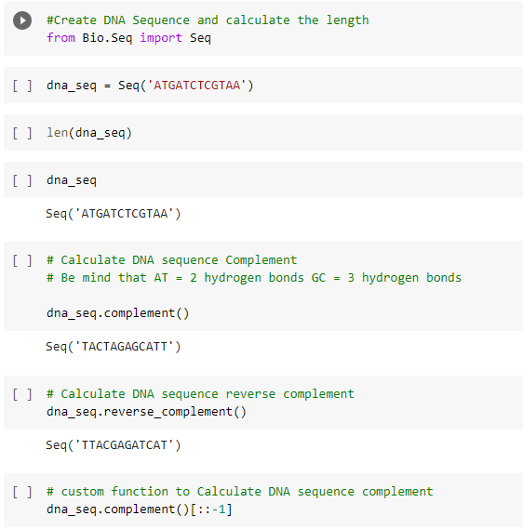
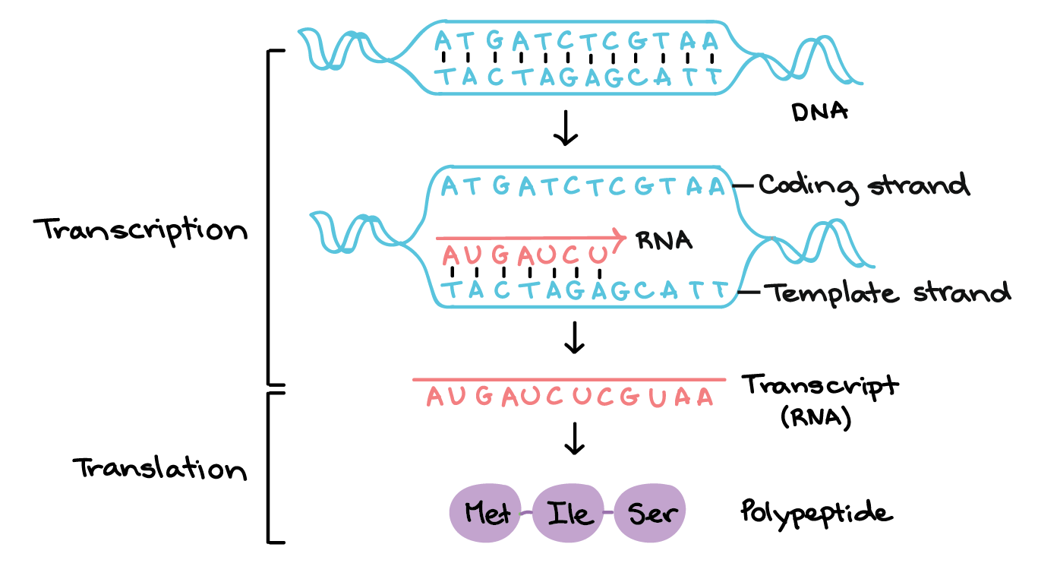
Protein Synthesis
Protein synthesis is how cellsmake proteins using 2 stages
Transcription
Translation

Slide 4
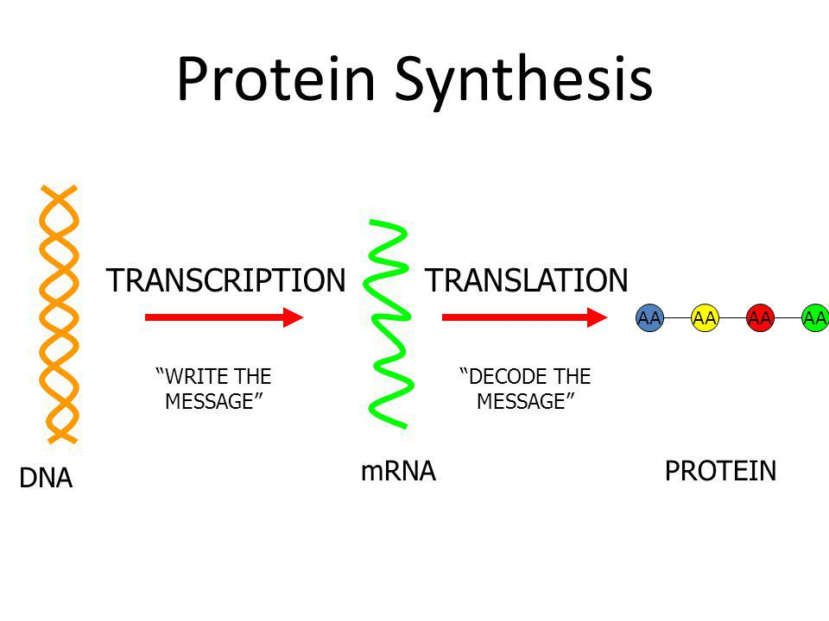
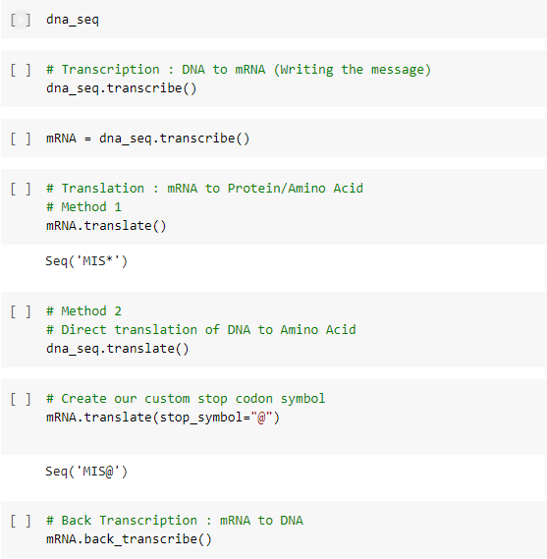
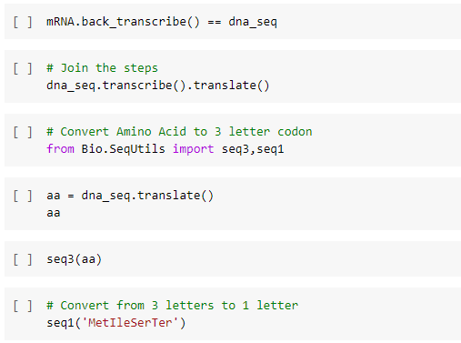

Slide 5
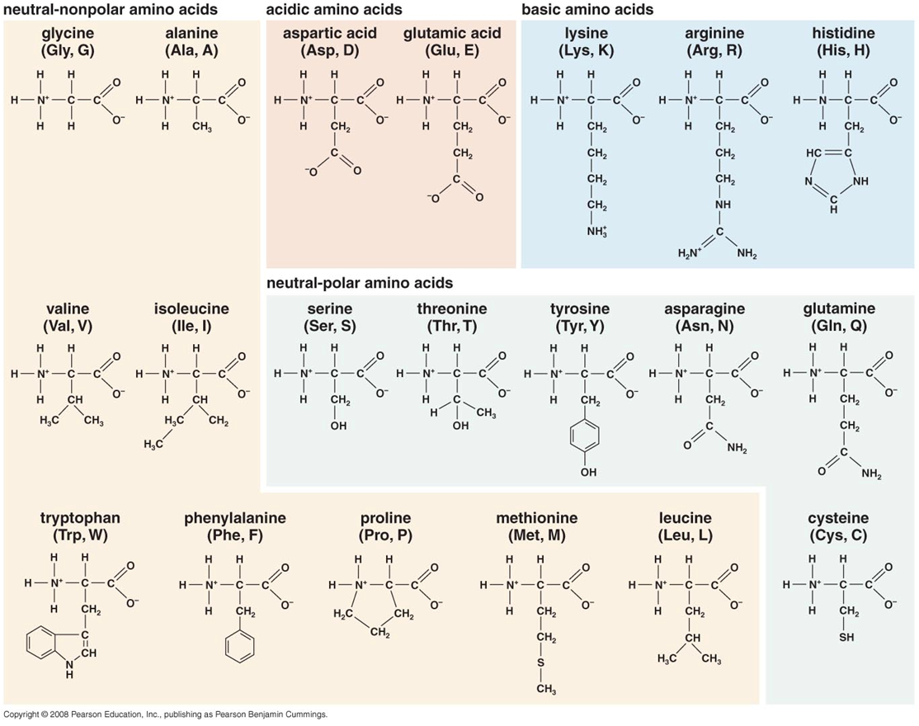
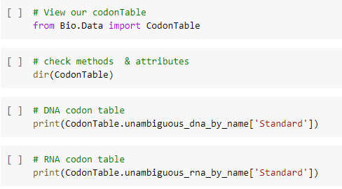
Amino Acids Codon Table

Slide 6
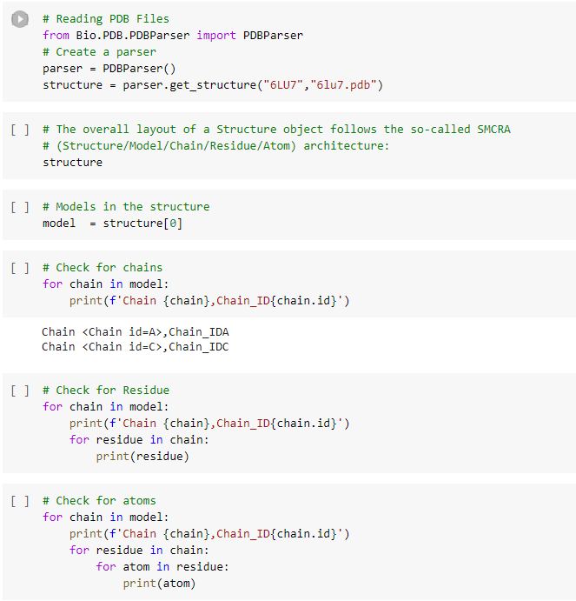
3D Structure of Protein
+ File Format
- pdb :PDBParser() legacy
- cif :MMCIFParser() recent
+ links
- https://www.ncbi.nlm.nih.gov/Structure/pdb/6LU7
- https://www.rcsb.org/search
- Protein Data Bank
+ Packages
- pip install nglview
- jupyter-nbextension enable nglview --py --sys-prefix
- nglview enable
- jupyter-labextension install @jupyter-
widget/jupyterlab-manager
- jupyter-labextension install nglview-js-widgets

Slide 7
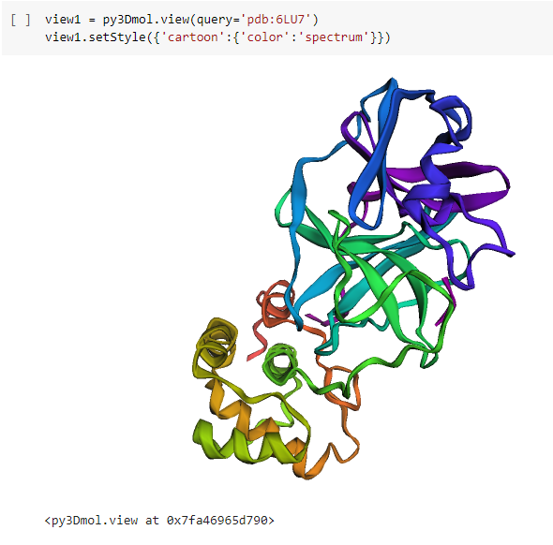
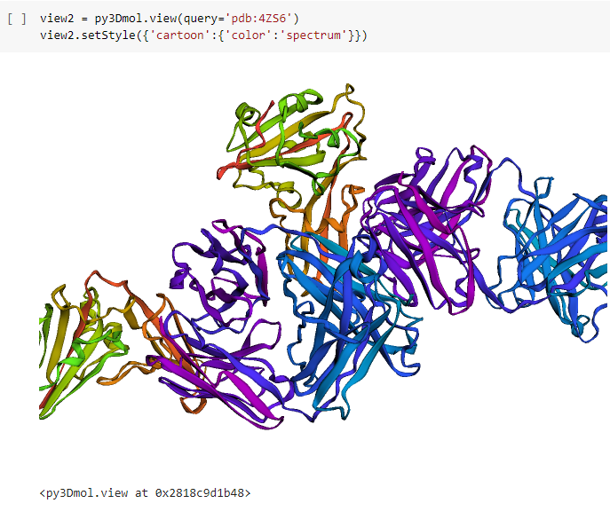
3D Structure of Protein

Slide 8
Exercise
Explore PDB so you can look for a certain protein
Find an example of any of your favorite protein in PDB.
Explain the 3D protein structure by looking at the description of secondary, tertiary, and quaternary protein structure

